Slide 1

UROP Project ID: UROP-2026-D874A2
A Hybrid Framework of Graph Algorithms and AI for Relational Modelling of Healthcare Data
Dr. Sheeja G, Assistant Professor (Sr. Grade)
Department of Mathematics,
Yash Sharma (RA2411003010957) CTECH
Yatharth Garg (RA2411003010744) CTECH

Slide 2
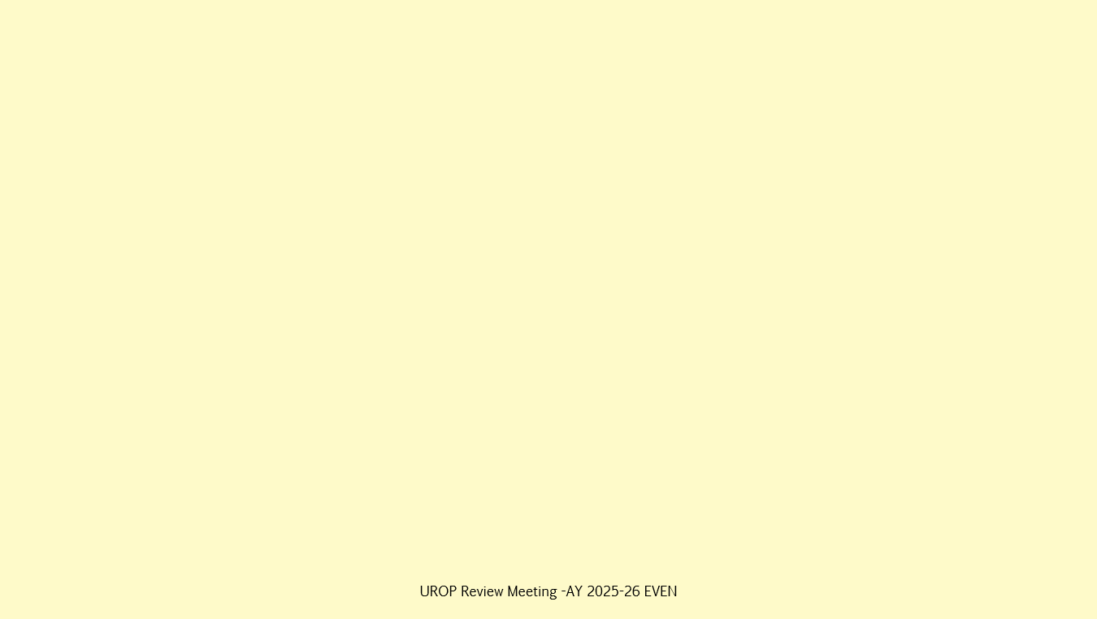
Problem Statement
Healthcare data is inherently relational, yet conventional machine learning models treat patient records as independent samples, failing to capture structural dependencies and contextual interactions. This project addresses this limitation by proposing a heterogeneous graph-based AI framework that integrates classical graph algorithms, graph embeddings, and graph neural networks to enable accurate and interpretable disease risk and complication prediction. The framework systematically combines structural analysis with predictive modeling to capture both local and global relational patterns in healthcare networks. Furthermore, the study performs a comparative evaluation of traditional machine learning, embedding-based learning, and deep graph learning approaches within a unified experimental setting. The outcome aims to provide improved predictive performance while maintaining transparency and reliability for real-world clinical decision support. Motivation To overcome the limitations of tabular machine learning by modeling complex healthcare relationships using graph-based representations, and to leverage hybrid AI techniques for improved predictive accuracy and interpretability. Additionally, this study aims to develop and evaluate a unified framework that systematically compares classical machine learning, embedding-based learning, and graph neural networks for clinical disease prediction.

Slide 3
Literature Review Summary
Healthcare data contains strong dependencies amongst patients, diseases, treatments, and outcomes.
Knowledge graphs provide an effective way to represent heterogeneous medical entities and relationships.
Hybrid AI systems combining symbolic reasoning and machine learning improve interpretability and trust.
Graph neural networks outperform traditional ML models in disease prediction tasks.
Explainable AI integrated with graph learning helps clinicians understand predictions.
Data modelling choices and graph structure significantly influence predictive performance.
There is limited work comparing classical ML, PCA-based learning, and GNNs within one unified framework.

Slide 4
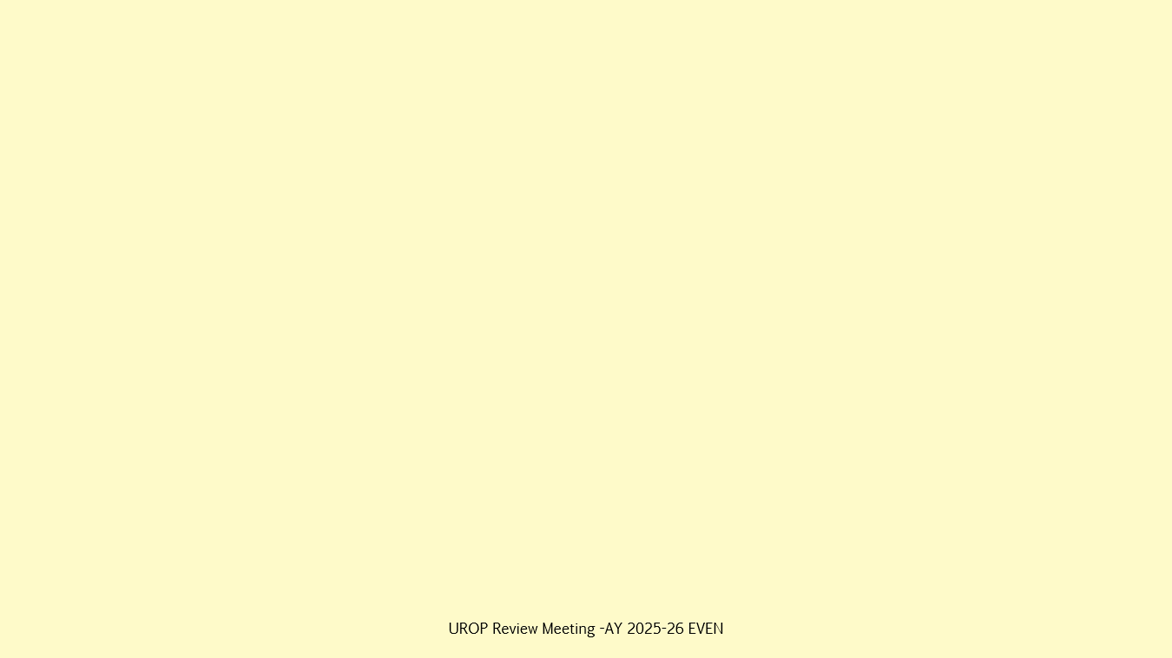
Methodology Adopted / To Be Followed
1. Data Acquisition
2. Data Preprocessing
3. Graph Construction
Collect structured healthcare dataset (patients, diseases, medications, lab results, visits).
Handle missing values
Normalise numerical features
Encode categorical attributes
Represent patients, doctors, diseases, medications, lab tests as nodes
Define relationships as edges
4. Structural Analysis using Graph Algorithms
5. Feature Engineering
6. Learning & Prediction
Generate graph-based structural features
Generate node embeddings (Node2Vec / DeepWalk)
Train traditional ML models
Train Graph Neural Networks
BFS / DFS for neighbourhood exploration
Dijkstra for shortest path
Centrality and clustering measures
7. Evaluation & Comparison
Compare accuracy of ML, embedding-based ML, and GNN models

Slide 5
Algorithms in Project Phases
Literature Phase (Study Only)
Experimentation Phase
BFS, DFS
Dijkstra
PageRank
Node2Vec
Graph Convolutional Network (GCN)
BFS / DFS
Dijkstra / Shortest Path
Degree Centrality
Clustering Coefficient

Slide 6
Learning Models
Node Embeddings
Traditional ML
Graph Neural Networks
Node2Vec
DeepWalk
Logistic Regression
Random Forest
XGBoost
Graph Convolutional Network (GCN)
Graph Attention Network (GAT)

Slide 7
Work Done So Far
Literature survey completed Comprehensive review of graph-based healthcare modeling, hybrid AI systems, and graph neural networks.
Problem statement finalized Clearly defined research gap focusing on relational modeling of healthcare data using graph algorithms and AI.
Project pipeline designed End-to-end workflow established, from data preprocessing and graph construction to learning and evaluation.
Algorithm stack selected Identification of classical graph algorithms, embedding techniques, traditional ML models, and GNN architectures.
Dataset identification in progress Evaluation of suitable healthcare datasets for graph-based representation and experimentation.

Slide 8
Results & Discussion
Literature-Driven Insights Graph-based models outperform traditional tabular methods for relational healthcare disease prediction.
Pipeline Feasibility Assessment The end-to-end pipeline is theoretically sound and aligns with established best practices for seamless preprocessing, learning, and evaluation.
Algorithm Suitability Analysis Selected algorithms and models balance interpretability through classical graph measures and strong predictive power using GNNs. Expected Performance Trends Embedding-based ML and GNN models are expected to outperform baseline ML in accuracy.
Current Limitations Quantitative results are pending until dataset identification and preprocessing are completed.

Slide 9
Work To Be Done
Finalize Dataset Selection & Acquisition Identify and procure an appropriate healthcare dataset suitable for heterogeneous graph construction.
Data Preprocessing & Feature Engineering Clean, normalize, and encode patient attributes; handle missing values and inconsistencies.
Graph Construction & Validation Model healthcare entities and relationships as a graph; validate structural correctness and connectivity.
Implementation of Graph Algorithms Apply BFS, DFS, shortest path, centrality, and clustering algorithms for structural analysis.
Embedding & Representation Learning Generate node embeddings using Node2Vec / DeepWalk for downstream learning tasks.
Model Training & Evaluation Train baseline ML models and Graph Neural Networks; compare performance across approaches.
Result Analysis & Discussion Analyze quantitative results, interpret model behavior, and relate findings to literature.
Documentation & Reporting Compile results into a structured report and prepare material for final presentation.

Slide 10
Contribution of each student team member
Contribution of Yash Sharma
Contribution of Yatharth Garg
Heterogenous Graph
Data Acquiring
Applying Graph Algorithms (BFS/DFS and Dijkstra only)
Use Algorithms to do clinical research (ML - LR, PCA with kNN, GCN)
Prediction Results - Unclear dependent on dataset.
Comparative Analysis (Which algorithm is the best at giving most accurate results.
Discussion and Limitations
Research Paper.

Slide 11
UROP Progress( Highlight your status of completion)
Work Done So Far
Phase1
10%
Literature Review
Problem identification
Objectives formulation
Phase 2 30%
Modelling
Simulation
Experiment
Phase 3 50%-70%
Analysis
Paper drafting
Phase 4 -80%
Paper Submitted to Journal
Under Review
Literature gap
Literature survey completed
Problem statement finalised
Pipeline designed
Algorithm stack selected
Dataset identification in progress

Slide 12
References
[1] Y. Chudasama, H. Huang, D. Purohit, and M.-E. Vidal, “Toward Interpretable Hybrid AI Integrating Knowledge Graphs and Symbolic Reasoning in Medicine,” IEEE Access, vol. 13, 2025, doi 10.1109ACCESS.2025.3529133.
[2] M.-E. Vidal, Y. Chudasama, H. Huang, D. Purohit, and M. Torrente, “Integrating Knowledge Graphs with Symbolic AI: The Path to Interpretable Hybrid AI Systems in Medicine,” Web Semantics: Science, Services and Agents on the World Wide Web, vol. 84, Art. no. 100856, 2025, doi: 10.1016/j.websem.2024.100856.
[3] E. Javid and W. Shah, “Hybrid AI Models for Large-Scale Information Extraction and Knowledge Map Construction,” Jan. 2025.
[4] M. Aamir, Y. K. Yu, N. Choudhry, and U. A. Bhatti, “Enhancing chronic disease management: hybrid graph networks and explainable AI for intelligent diagnosis,” Sci. Rep., vol. 15, 2026, doi: 10.1038/s41598-025-34065-5.
[5] S. Safaei, “Evaluating hybrid AI for prediction over lung cancer knowledge graphs,” Master’s thesis, Gottfried Wilhelm Leibniz Universität Hannover, Hanover, Germany, 2024.
[6] H. Lu and S. Uddin, “Disease Prediction Using Graph Machine Learning Based on Electronic Health Data: A Review of Approaches and Trends,” Healthcare, vol. 11, Art. no. 1031, 2023, doi: 10.3390/healthcare11071031.
[7] J. Schrodt, A. Dudchenko, P. Knaup-Gregori, and M. Ganzinger, “Graph-representation of patient data: a systematic literature review,” J. Med. Syst., Mar. 2020, doi: 10.1007/s10916-020-1538-4.
[8] J. G. Diaz Ochoa and F. Mustafa, "Graph Neural Network Modelling as a potentially effective Method for predicting and analyzing Procedures based on Patient Diagnoses," medRxiv, (Preprint). Nov. 25, 2021. (Online). Available: doi.org.

